Slide 1


Tables with summary statistics of numeric variables
Rural
City

Slide 2


Boxplots of prices per m2
Rural
City

Slide 3


Boxplots of areas
Rural
City

Slide 4
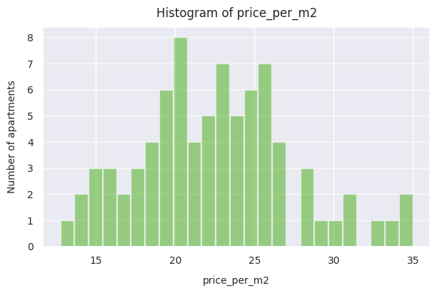
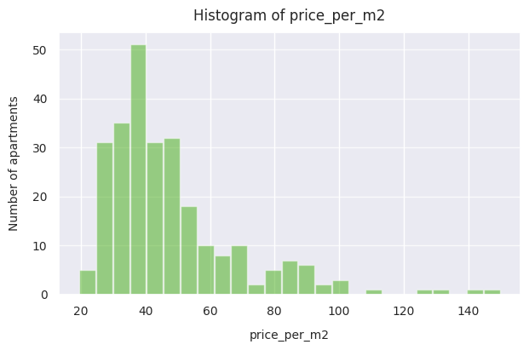
Histograms of prices per m2
Rural
City

Slide 5
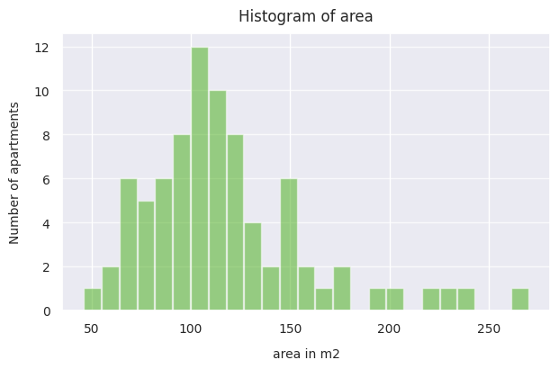
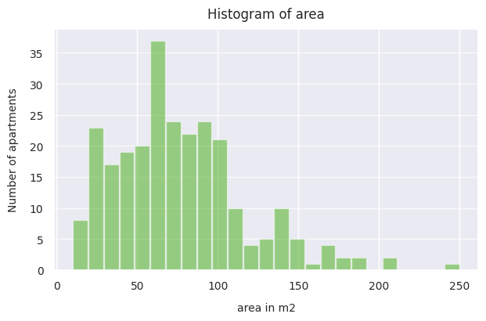
Histograms of areas
Rural
City

